Slide 1
Engaging with Massive Open Online Courses
Research Analysis Presented By:
Ishan Dutta

Slide 2
Contents
1. Introduction
2. Patterns of Student Activity
3. Grades and Student Engagement
4. Course Forum Activity
5. A Large Scale Badge Experiment
6. Insights
7. Analyzing Stack Overflow Badge System
8. Conclusion

Slide 3
Introduction
Proposes a Framework on student engagement with MOOCs.
Are University Education intuitions applicable to MOOCs? - Imp. for future structure of courses.
2 Main Focuses:
Engagement Styles - A Taxonomy Based on Data
Course Forums - Badge System

Slide 4
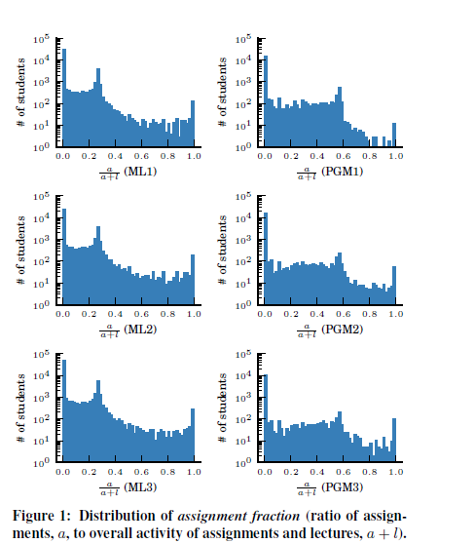
Engagement Styles:
Viewers
Solvers
All Rounders
Collectors
Bystanders

Slide 5
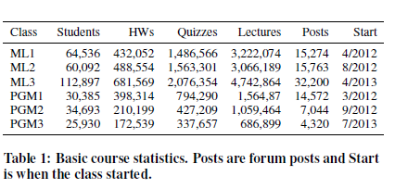
Deploying Badges in Forums
Higher Engagement
Making Badges more salient
Exp. - Names with Badge

Slide 6
2. Patterns of Student Activity
Engagement Styles
Time of Interaction

Slide 7
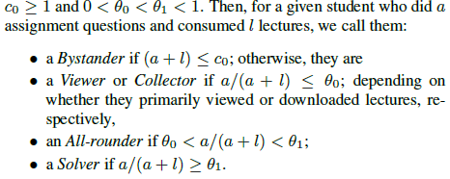
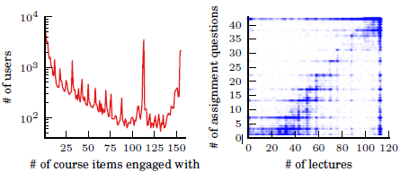
Engagement Styles

Slide 8
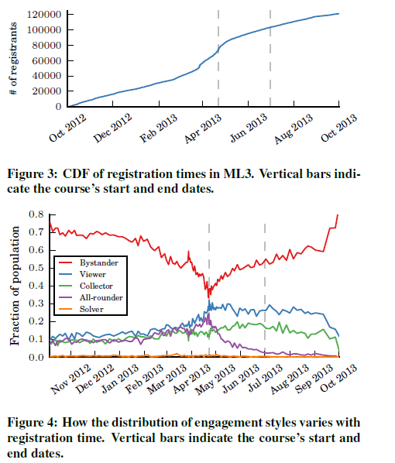
Time of Interaction
18%
60%

Slide 9
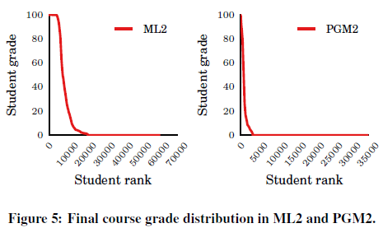
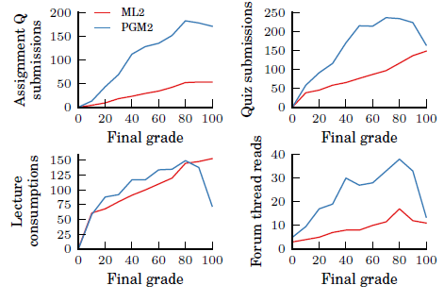
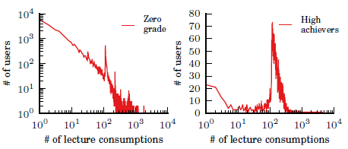
3. Grades and Student Engagement

Slide 10
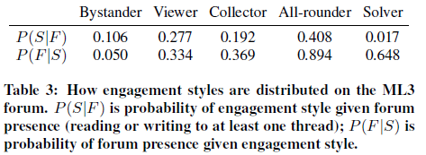
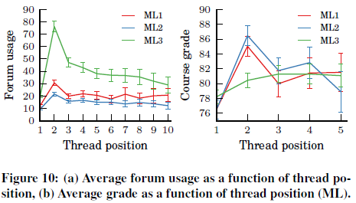
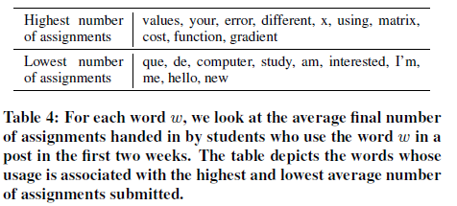
4. Course Forum Activity

Slide 11
5. Large Scale Badge Experiment
Badge System
Badge Presentation

Slide 12
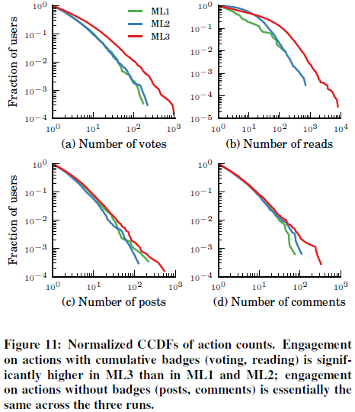
Badge System

Slide 13
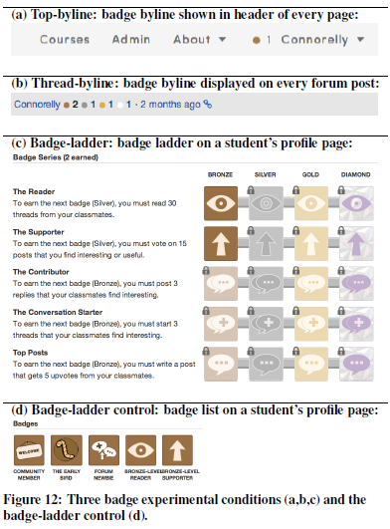
Badge Presentation
Personal Achievements
Social Status

Slide 14
6. Insights
Students show a particular pattern of Engagement of MOOCs.
Traditional meaning of “Complete” may not be appropriate for MOOCs.
Course Bystanders can be clearly differentiated from other categories.
Badge Systems affect the Student Engagement in a non-trivial manner.
Instead of one “Super-Badge”, cumulative Badges show better results.
Badge Ladder is more effective that Badge Bylines.
Making further badge achievements clear increases engagement.

Slide 15

Analyzing
Stack Overflow Badge System

Slide 16
Types of Badges
BRONZE - Basic use: posting questions, answering questions, voting up or down, tagging posts, editing, filling out your user profile.
SILVER - Experienced users - continued participation
GOLD - Most committed users - skilled, knowledgeable, and dedicated to earn these.

Slide 17
Classification of Badges
Question
Answer
Participation
Moderation
Other

Slide 18
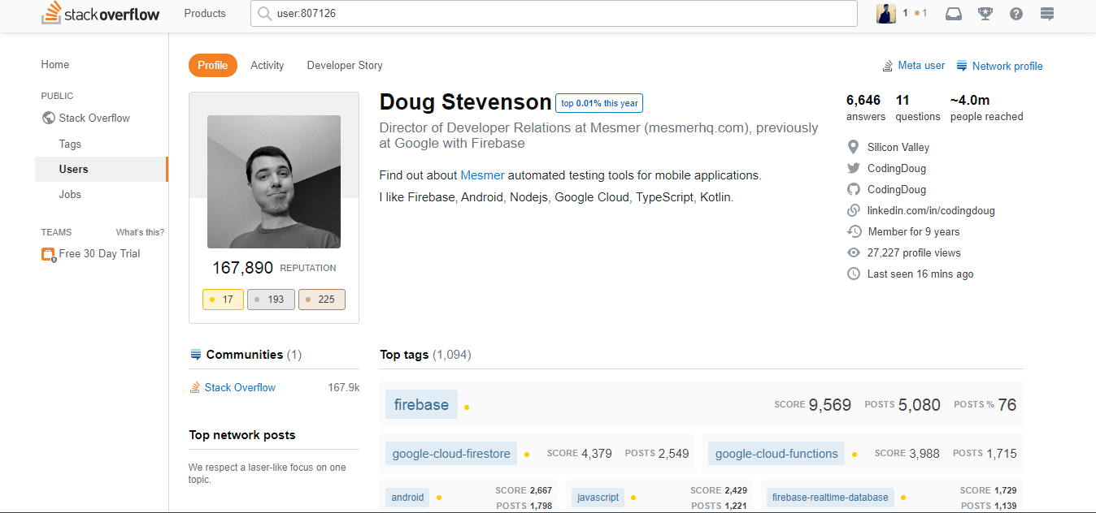

Slide 19
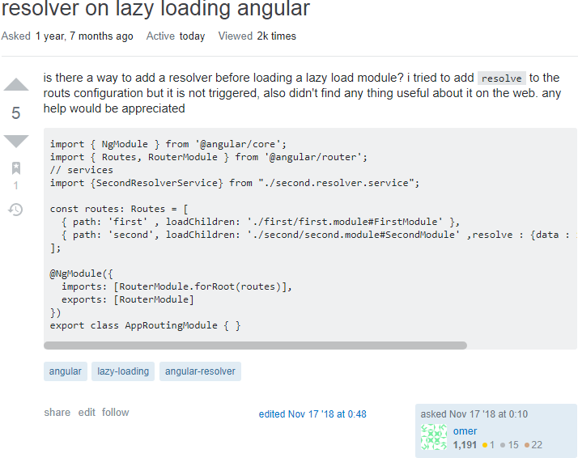

Slide 20
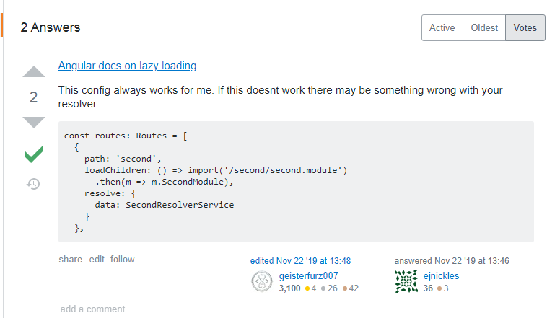

Slide 21
Conclusion
Badge Systems can significantly affect the User Interaction.
Authenticity of User.
Helps to improve content and prevent spamming.

Slide 22
Thank You.

